Slide 1
Neural networks– Perceptron

Slide 2
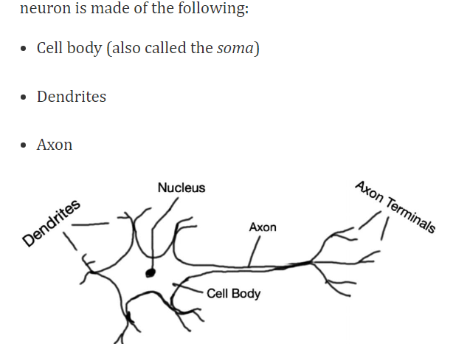
Neuron

Slide 3
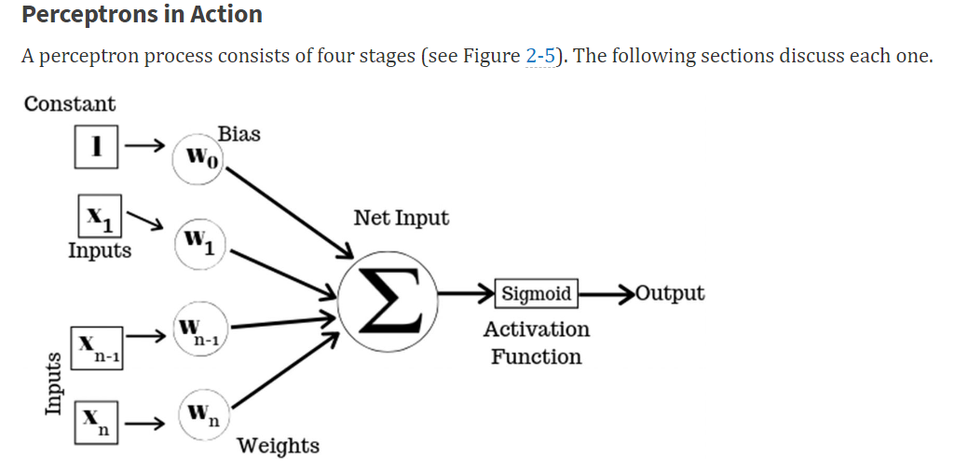
Perceptron = 1 Neuron

Slide 5
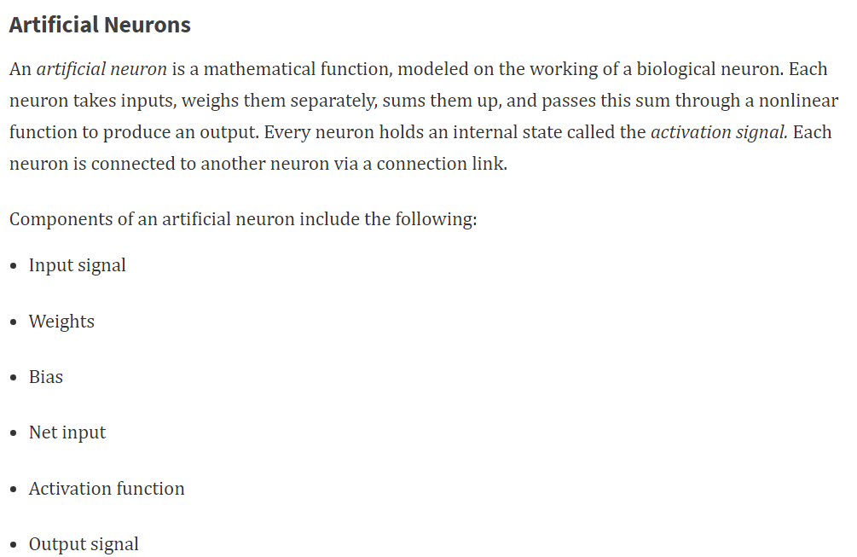

Slide 6
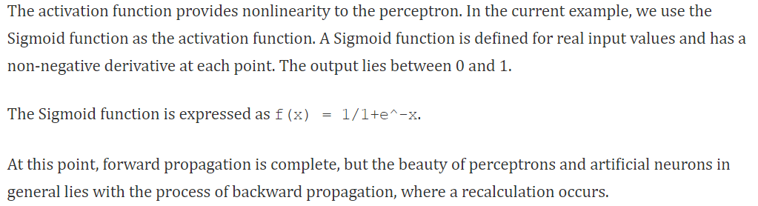
Activation function

Slide 7
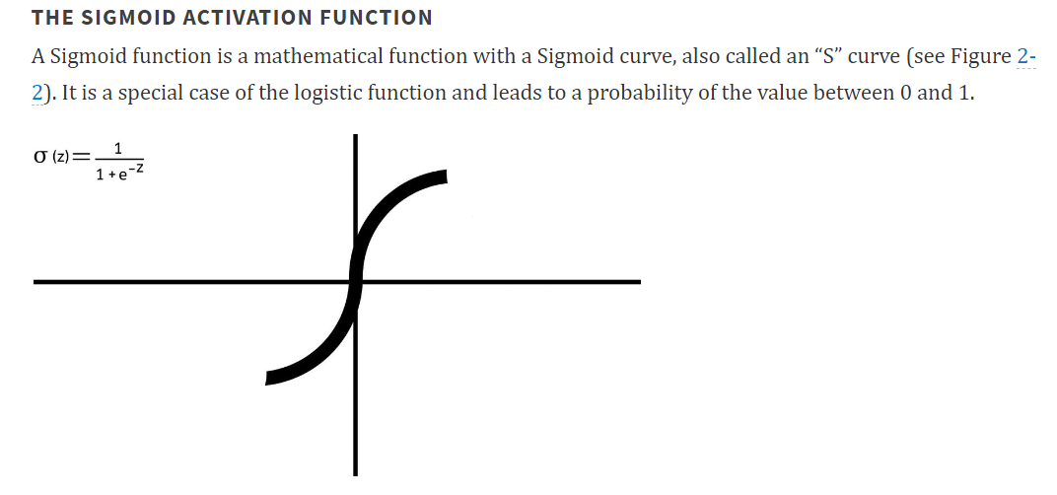

Slide 8
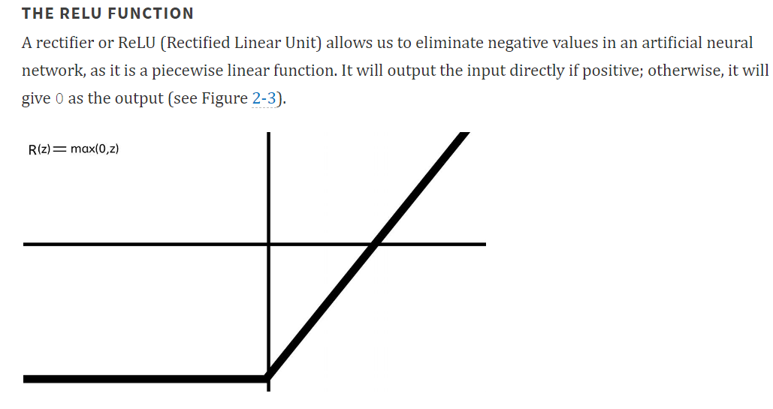

Slide 9
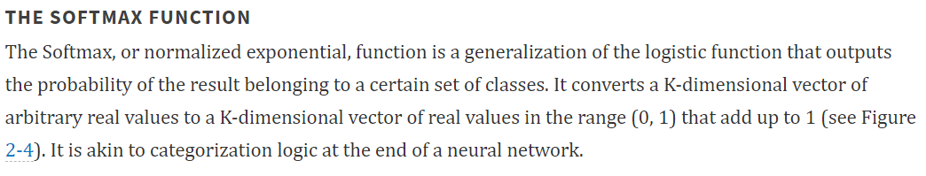
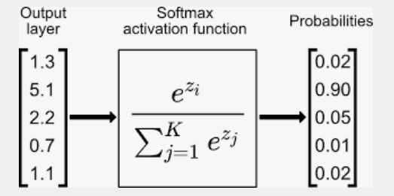

Slide 10
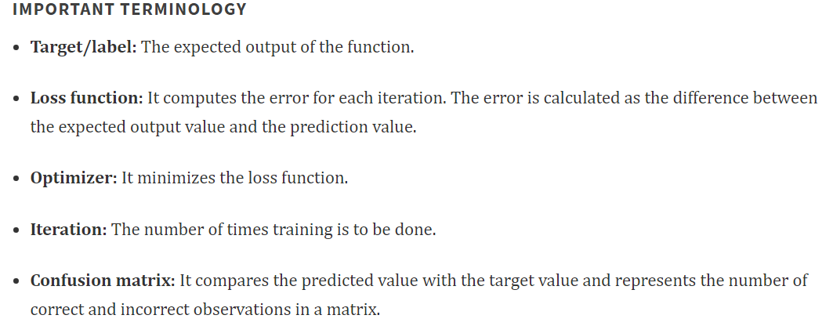

Slide 11
Layers with neurons

Slide 12
Layers with neurons

Slide 13
Cost function

Slide 14
Cost function – example

Slide 15
Cost function – example

Slide 16
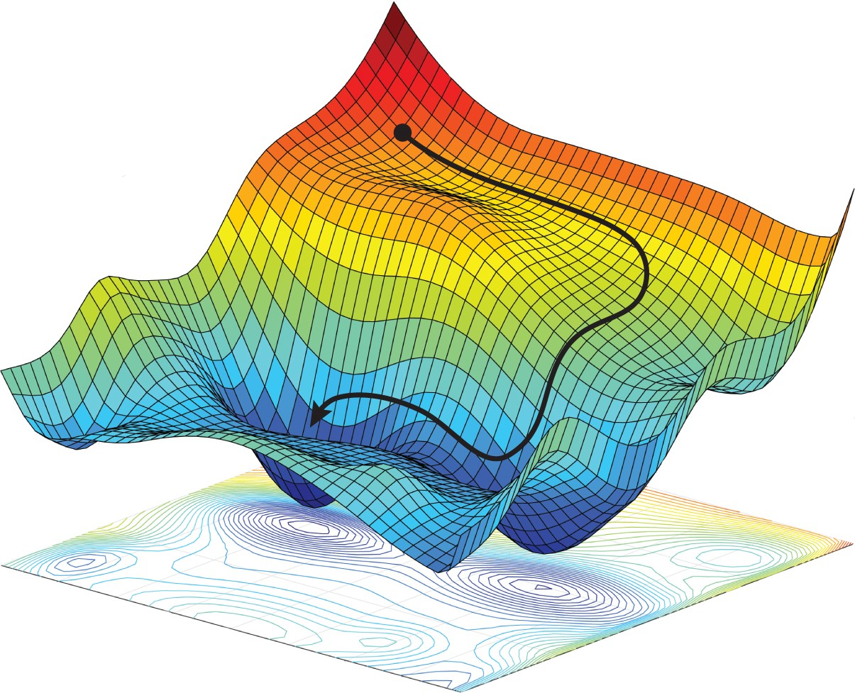
Cost function and Optimizer

Slide 18
Backpropagation
Vanishing gradient
and
Exploiting gradient

